Slide 1
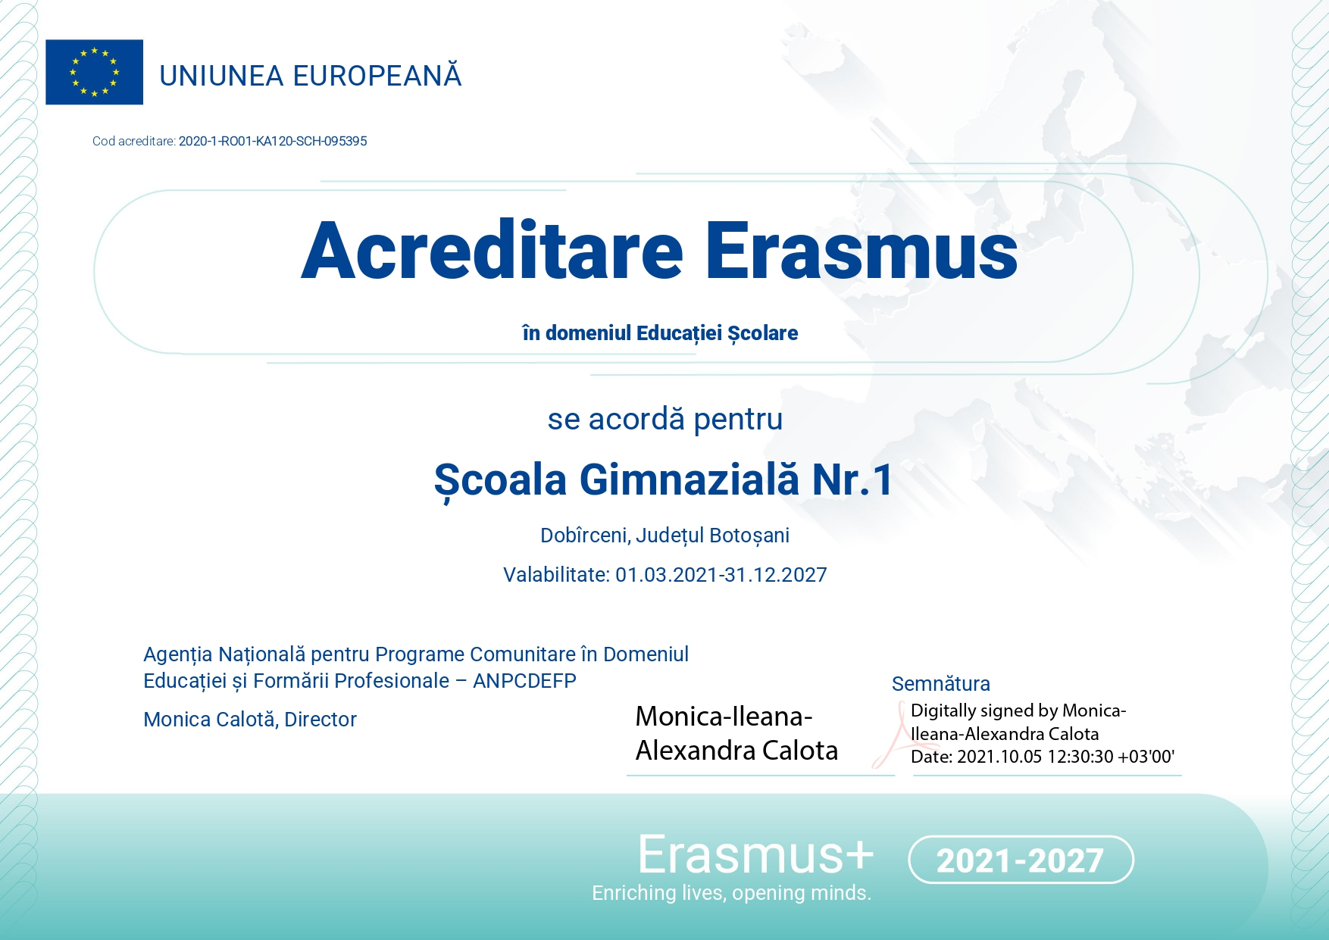
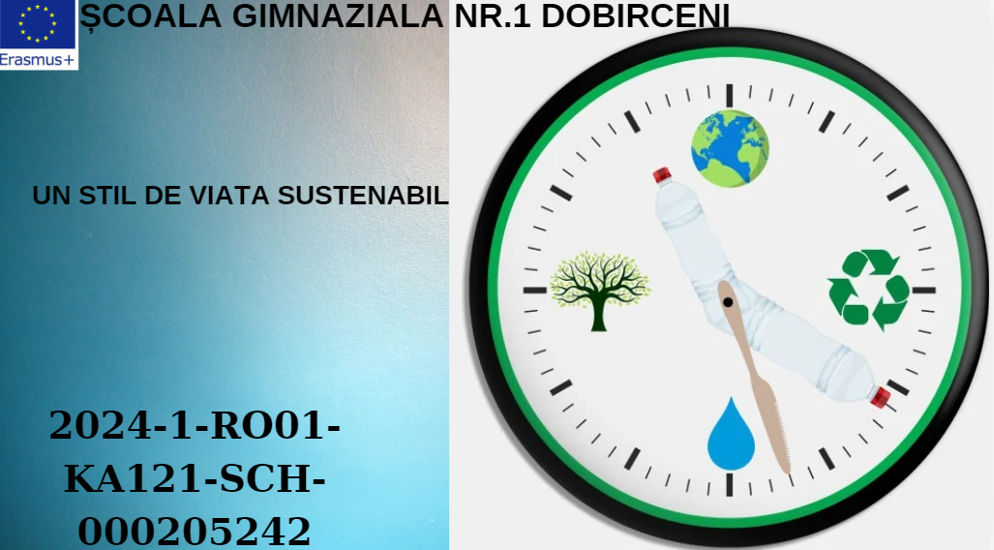
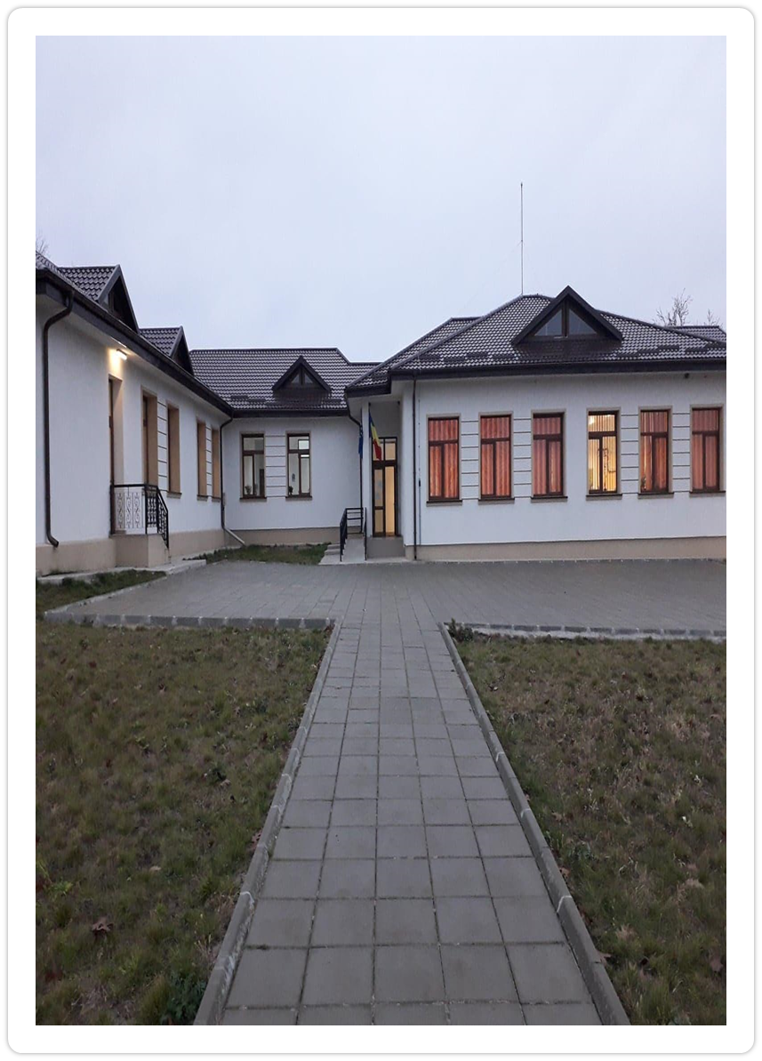
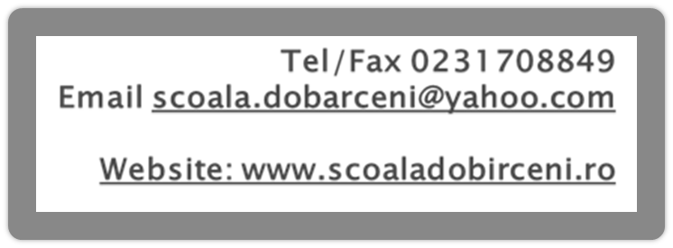

Slide 2
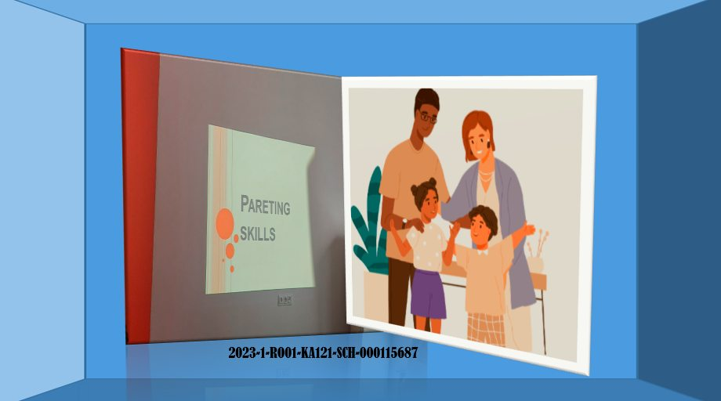
2022-1-RO01-KA121-SCH-000064968
2021-1-RO01-KA121-SCH-000010947
2023-1-RO01-KA121-SCH-000115687

