Slide 1
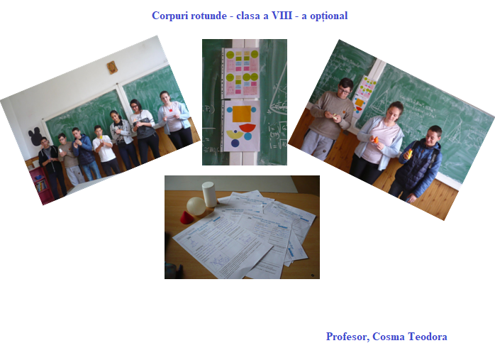
http://mathematicalvariety.blogspot.com/2019/05/corpuri-rotunde-clasa-viii-optional.html

