Slide 1
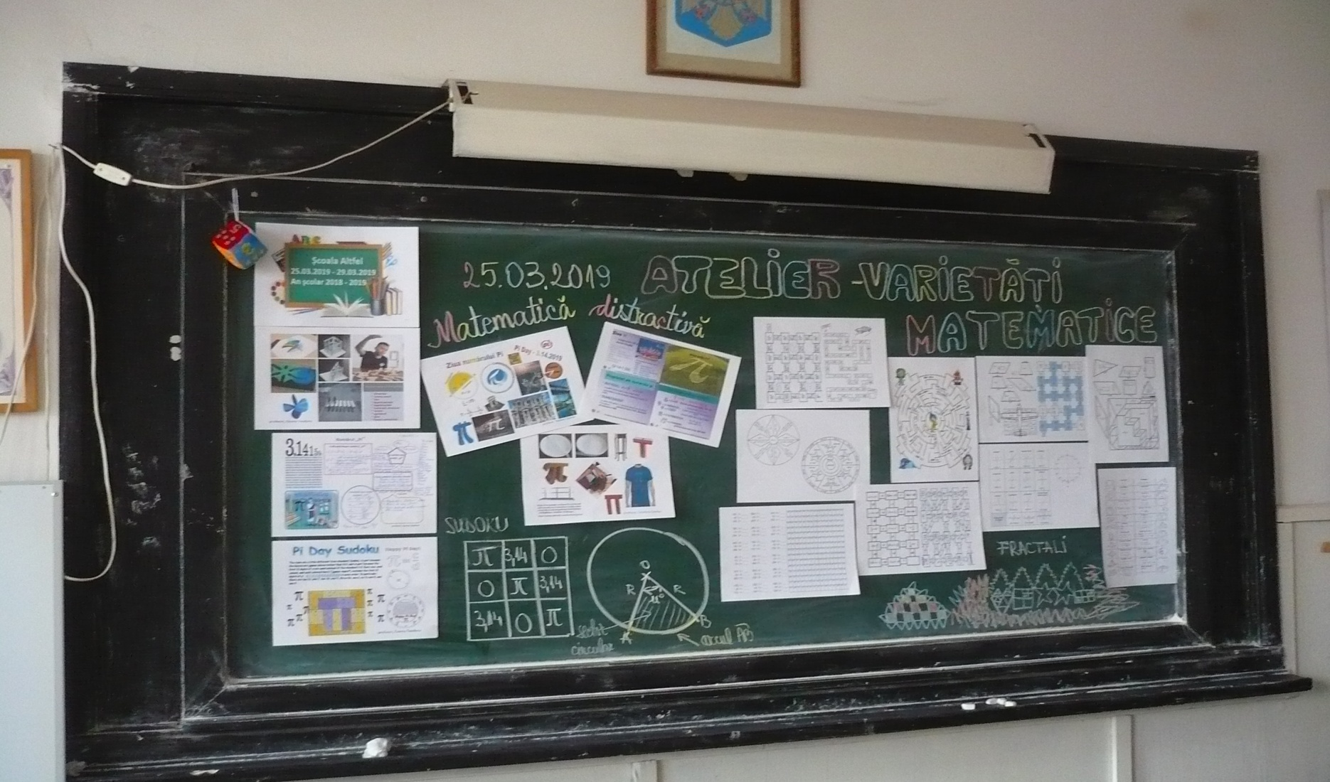
http://mathematicalvariety.blogspot.com/2019/03/scoala-altfel-2019.html

