Slide 1
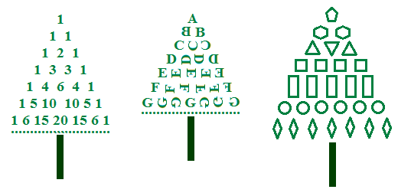
MATH IS FUN
Pascal's Triangle
Geometric Figures
Rotation
Symmetry
Translation

