Slide 1
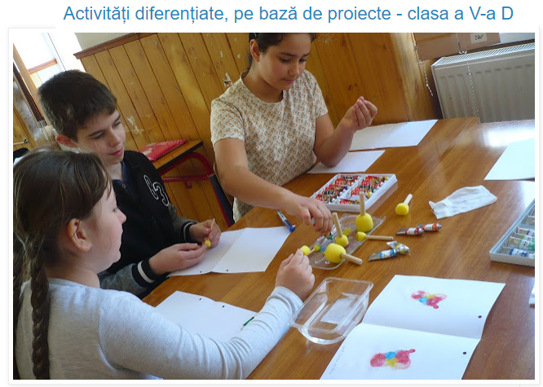
https://mathematicalvariety.blogspot.com/2019/04/activitati-diferentiate-pe-baza-de.html

